Slide 1
KANTIAN ETHICS
Lesson 1 : Duty

Slide 2
Topic Checklist
Explain how Kant uses the idea of duty in his ethical theory
Explain the difference between hypothetical and categorical imperatives
Explain the three formulations of the categorical imperative: universal law, end in itself, and the kingdom of ends.
Explain how Kant’s ethics is based on assumptions about freedom, immortality and God
Assess whether Kantian Ethics enables us to make good moral decisions
Consider whether the idea of doing your duty is what makes an action right or wrong
Consider criticisms of Kantian ethics such as its rejection of emotions/love and its abstract and impractical nature

Slide 3
TASK 1
Review of ethical theories
Absolutism, Relativism, Deontological, Teleological.
What do the 4 words above mean?
In 1-2 sentences how do Utilitarians make moral decisions?
In 1-2 sentences how do supporters of Natural Law make moral decisions?
In 1-2 sentences how do supporters of Situation Ethics make moral decisions

Slide 4
4 situations to think about
Morally right or morally wrong??
Your teacher is teaching your class really well. She plans to use your results when she next applies for a promotion.
The local shopkeeper charges fair prices and will tell you if you accidentally pay too much. He knows that honesty is good for business
You promised your gran that you would visit but you have no intention of going. She is very forgetful anyway
Steve and his 3 friends push their car that has run out of fuel. Steve notices that the friends are strong enough to push the car without him. So he walks along pretending to push.

Slide 5
Today
The key idea of our 4th and final ethical theory is that we should do our duty
The next few slides will help us to get some understanding of what duty is.

Slide 6
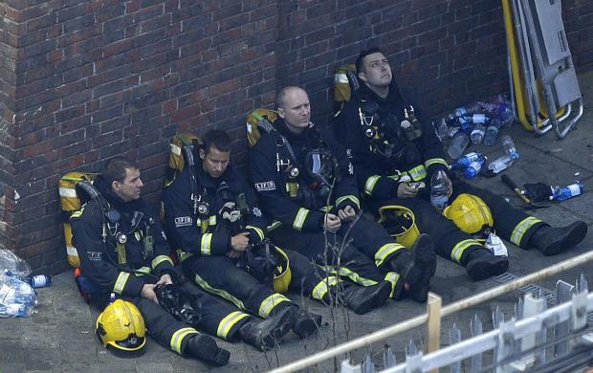
Firefighters
These firefighters spent all night tackling the Grenfell Tower blaze.
They would say that they have just done their duty

Slide 7
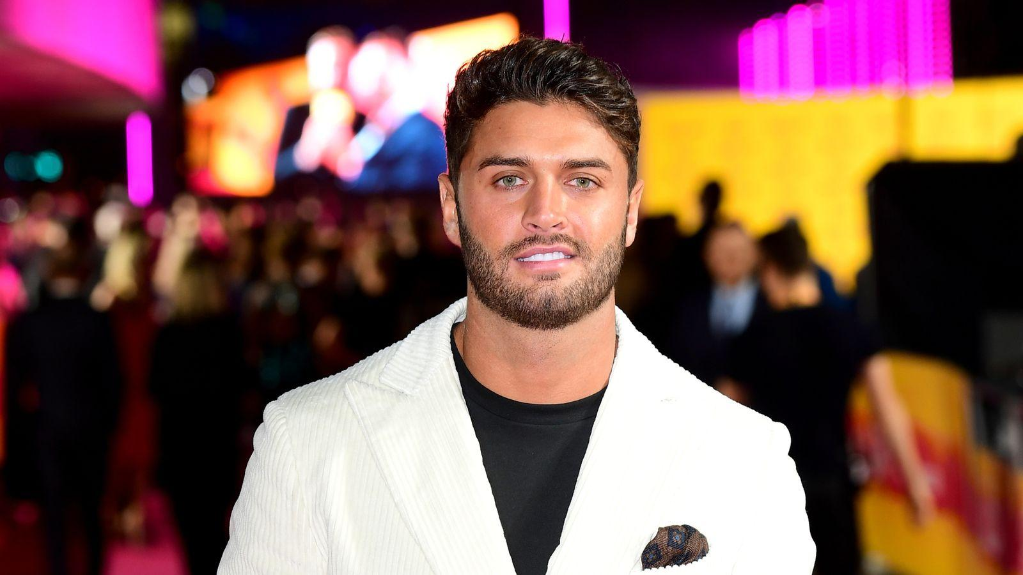
Duty of Care
Following the suicide of former Love Island contestant Mike Thalassitis - the health secretary suggested that the programme makers owe contestants on such shows a duty of care

Slide 8
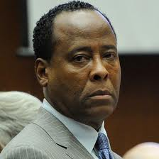
Who is he? Why is he famous?
If you had done what he had done, would you be treated differently

Slide 9
What can we expect of our doctors
Dr Conrad Murray was held responsible for his part in the death of Michael Jackson. Unlike you or I, he should have known and been able to foresee the effects of the medication he gave Jackson. He failed in his duty to his patient

Slide 10
Some professions and roles have duties that seem obvious
Politician
Friend
Police Officer
Soldier
Duty
Doctor
Pilot
Parent
Teacher

Slide 11
Duties
Duties are things that we owe to other people. They don’t depend on our feelings or outcome. (A police officer is required to give chase to the suspect whether they feel like it or not)
Kant’s idea is that all of as human beings have duties - ways that we should logically treat others - and we should expect others to fulfil their duties to us
Our aim should be to do our duty - whether we get anything out of it or not!

Slide 12
What if
DISCUSS:
How do the duties of the people you are looking at change IF. . .
1. They do not feel like carrying out their duty
2. There would be better consequences if they did not do their duty

Slide 13
Kantian ethics – some key points
Kantian Ethics is ABSOLUTIST and DEONTOLOGICAL – the theory says that there are some actions that are always right/wrong and they are right/wrong regardless of consequences
Your Duty IS your duty - it doesn’t change. It doesn’t matter what you feel like or what the consequences are.
Do Your Duty! It makes logical sense
Next Time: How do I work out what my duty is?

Slide 14
Task 2
Use this ppt and p18 of the Eyre & Waterfield revision guide.
Write a paragraph explaining Kant’s ideas on Good Will and Duty.

Slide 15
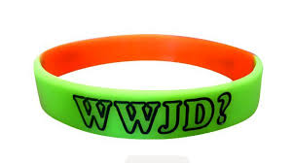
Task 3
Your teacher is teaching your class really well. She plans to use your results when she next applies for a promotion.
The local shopkeeper charges fair prices and will tell you if you accidentally pay too much. He knows that honesty is good for business
You promised your gran that you would visit but you have no intention of going. She is very forgetful anyway
Steve and his 3 friends push their car that has run out of fuel. Steve notices that the friends are strong enough to push the car without him. So he walks along pretending to push.
K
Kant’s thoughts about the dilemmas above would be very similar. What would he say might be the issue in these cases?

Slide 16
Task 4
Copy and Complete the Table
Theory | Absolute or Relative | Deontolgical or Teleological
Utilitarianism | Relative | Teleological
Natural Law
Situation Ethics
Kantian Ethics

