Slide 1
Thinking Skills
Session 8 : Developing your own argument

Slide 2
Assess the view that cats are better than dogs
First – what is your conclusion
Second – what are your reasons (these are your building blocks)
Third – can you bring in a counterargument
This is your structure
Harder – can you assess and weigh the ideas as you present them?

Slide 3
Describing Ideas - JOURNALISTIC
Cats are 4 legged creatures with tails and whiskers.
Johnson states that cats are a good pet because they go to the toilet outside. Higgins suggests that the fact you don’t need to walk cats is a very good thing
Mahmood shows that cats are less scary than dogs as they don’t make loud noises.
Dogs come in lots of different varieties. They bark a lot.
Simpkins states that dogs are good for you as you get exercise having to walk them. McGregor also thinks that dogs are better as they can guard the house and no one has ever said ‘beware of the cat’, in addition no one has ever used guide cats to help the blind
There are lots of good arguments about cats and dogs and different people prefer different pets

Slide 4
Assessing the argument - LAWYER
“Whilst one argument given by Higgins suggests that cats not needing a walk is a good thing (CA) it is not clear that he is right. He correctly states that you save time by not needing to walk the cat, but the advantages of owning a dog actually outweigh this. Simpkins points to the exercise that dog owners get and the scientifically proven health benefits to people of getting fitter. Dog owners are on average 10% less likely to be overweight than cat owners. Hence it seems unclear that the argument in favour of cats bears any weight.

Slide 5
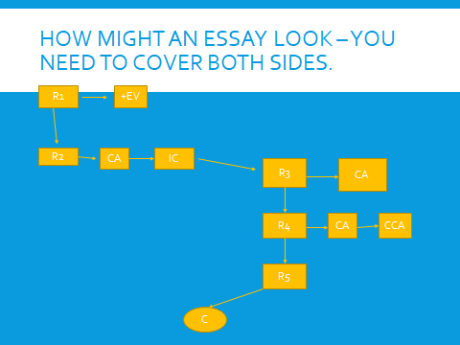

Slide 6
Indicator Words
You can give clues to your reader to show what stage of the argument you are at
Therefore, So, Hence, this suggests that (show conclusions or intermediate conclusions)
Firstly, futhermore, A key reason that (might show reasons)
However, one response to this view (might show counterargument)
Draw up a list of your own indicator words. They act as signposts and links that help the flow of the essay

Slide 7
Task
Produce an argument on a topic of your choice.
You will need to show your structure, give reasons, consider counterarguments and be the ‘fair lawyer’ as we described in class.

