Slide 1
Welcome to Philosophy
What if everything you know is wrong?

Slide 2
Starter
Please write down 3 things that you are confident that you know are true. Eg) things you learned in history, maths, science, facts about school, your family etc.)

Slide 3
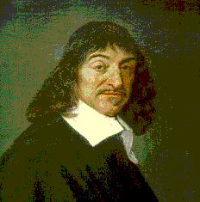
Descartes’ Meditations
In 1641 French Philosopher Rene Descartes sets out to establish what he can know.
Yet oddly enough – his first step is to show what you can’t know

Slide 4
Descartes’ Doubts
Descartes decided that he can only accept things as knowledge if he is absolutely 100% certain of that fact
He raises 3 possible reasons to doubt many of the things that we might think are true. Perhaps everything he had ever been told was wrong…

Slide 5
1. The argument from senses
In the past our senses have sometimes deceived us (the bent stick in water)
So it is just possible that they are always deceiving us
NOW we have to reject anything that comes form our senses

Slide 6
IDEA 1: I can’t trust my senses. (after all they have let me down in the past)
Discuss: When do your senses let you down? Is he right that we should never trust them? Does everything come from our senses?
Does everyone see the same blue? Who is right?
Who hears correctly – you or your dog?
Do people get shorter as they walk away?
Are there statements you need to cross out?

Slide 7
2nd The Argument from Dreaming
It is possible to have a dream that is so vivid and lifelike that one is completely taken in by it at the time.
So it is just possible that my present experience (indeed all of them) is just a vivid dream
CAN ANYTHING survive this second wave of doubt?
This particularly affects those ideas which come from memory
Are there statements you need to cross out?

Slide 8
From the Matrix Trilogy

Slide 9
What is left?
Philosophers divide knowledge into A Priori (we can know this without senses/experience) and A Posteriori (we have to use the senses to know this)
So A Priori (Maths) and A Posteriori (Science)
Have we got this? Can we write one example of each?
It might look as if the A Priori is safe but Descartes has a 3rd wave in mind. This might be scary…

Slide 10
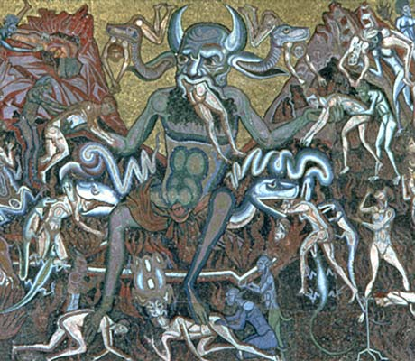
3. Descartes’ Deceiving Demon

Slide 11
The Evil Demon explained
What if instead of a God, there is an evil demon in charge of the universe.
He is so evil (and tricksy) that he deceives me about everything. It makes me think that the world is real, that 2+3=5, that this body is mine etc.
This demon (who could exist!), dreams and my dodgy senses mean that I can never ever know anything
Are there statements you need to cross out?
What knowledge do you have left? Descartes thinks it is possible to doubt everything. (Well almost…)

Slide 12
Now the good news
Here’s how he gets out of it…

Slide 13
The Escape
Even if I am being deceived, I have to exist in order to be deceived.
Even if I doubt, doubt is a type of thought
‘I think therefore I am’
I KNOW that I currently exist – not even the evil demon can trick me on this.

Slide 14
But there’s more…
Descartes goes on to argue for the existence of the soul
REMEMBER: If two things are the same they must be exactly the same; everything that you can say about one thing MUST be true of the other
R1: I can doubt whether my body exists
R2: I cannot doubt that ‘I’ exist
C: Therefore I am not just my body

Slide 15
Here’s an argument for God
R1: I have an idea of a perfect being – God
R2: I am an imperfect being
R3: An imperfect being cannot create the idea of perfection
C: Therefore the idea of God can only be in our minds because God has put it there

Slide 16
Here’s another argument for God
R1: God, if he exists, is defined as a perfect being
R2: A perfect being must be perfect in every way that it is possible to be perfect.
R3: Existence is one of these perfections
C: Therefore God has to exist

Slide 17
Introducing RS & Philosophy at A Level
Religious Studies
Philosophy of Religion, Ethics and Developments in Christian Thought
100% Pass rates, good levels of high grades
Taught by senior examiner/authors
Very high student satisfaction scores
Philosophy
Questions about Knowledge, the Mind, Ethics and God
100% pass rates
Very high student satisfaction scores
Great links with universities and outside speakers

